Slide 1




Hands-On MLOps - Bootstrapping Your First ML Project from Start to Finish.

Slide 2
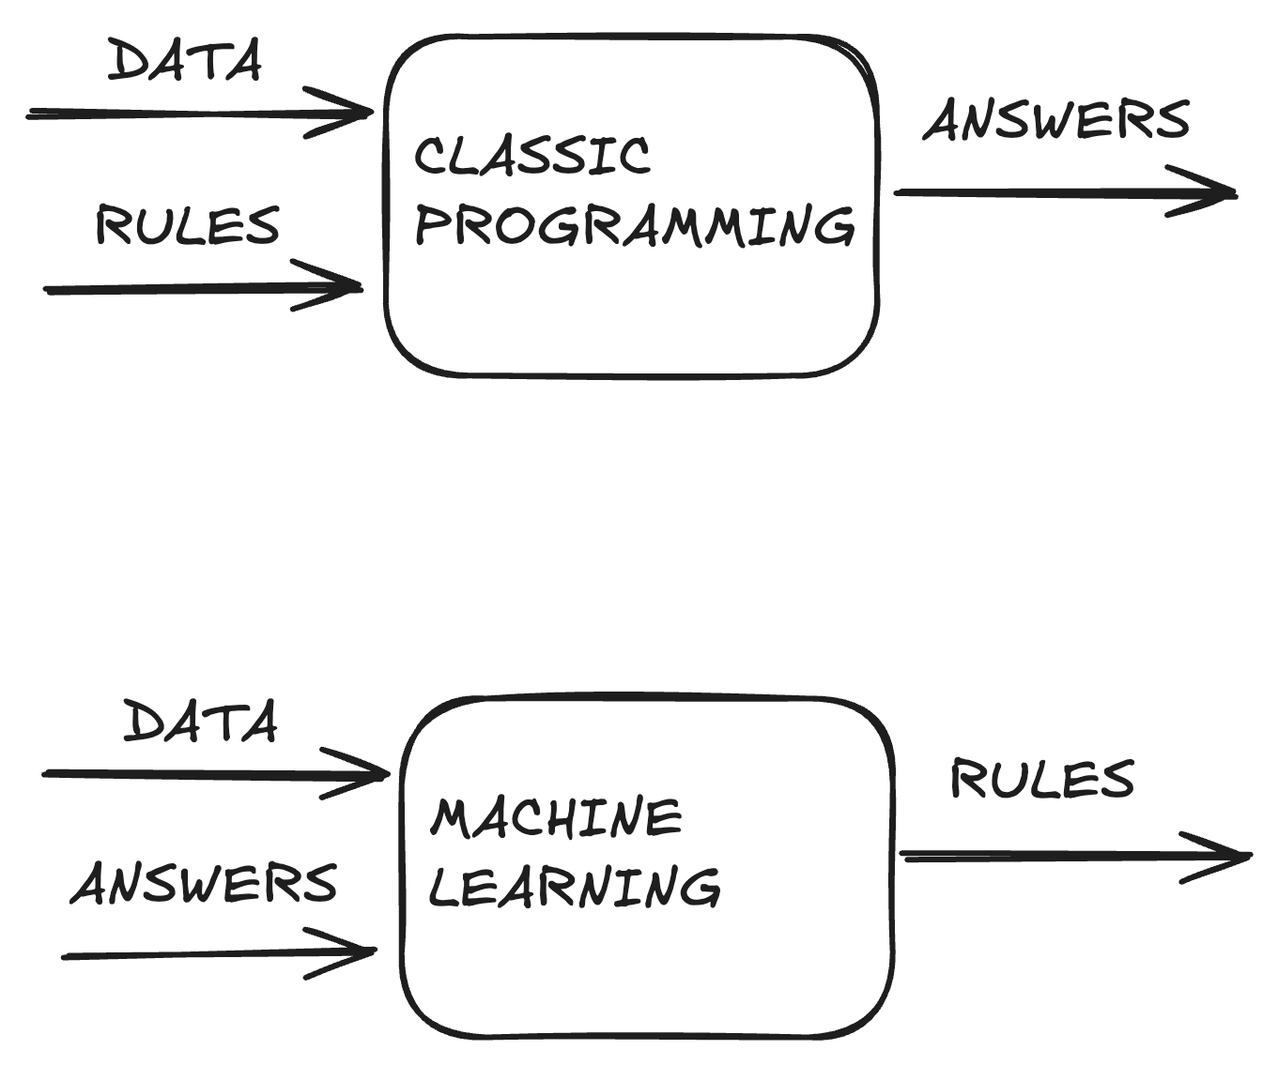
ML?

Slide 3
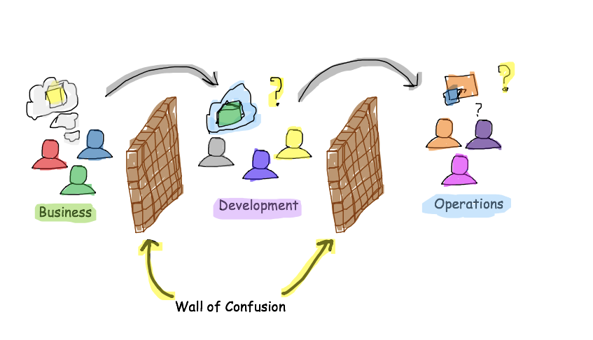
DEV(SEC)OPS?

Slide 4
MLOPS?
Configuration
Data Collection
Data Verification
Machine Resource Management
Serving Infrastructure
Monitoring
ML Code
Analysis Tools
Feature Extraction
Process Management Tools
Source : Google, The Hidden Technical Debt In Machine Learning Systems

Slide 5




27 Practices| These capabilities gather ~200 MLOps capabilities
Fundamentals
Reliable
Repeatable
Scalable
All the basics practices required to go to production
Mature practices ensuring the reliability of the AI Product
Automated practices accelerating the time to market
All the practices scaling AI products and codifying the best practices
Model training & Tuning
FinOps
Infrastructure as code
Development Templates
Project, model & technical
Documentation
Model Quality Gates
Artefacts & packages
CI/CD Templates
Monitoring Business Performance
Versioning
Advanced Automation
Feature Extraction Process
Reliable CI/CD pipelines
Traceability & reproductibility & automation
Git Strategy
Security
Management, Tools
Monitoring Application, Infrastructure
Repeatable CI/CD pipelines
Data Collection
Code Quality Gates
Maintenance
Notebook & Code, Strategy
Data Quality Gates
Feedback loop
Monitoring Data drift & outliers and model
Deployment Strategy
Multi-environment
AI Governance
Preprod testing
Notes:
Inverser repeatable et reliable
Rajouter glossaire
Rajouter le lien de la communauté internationale

Slide 6
27 Practices| These capabilities gather ~200 MLOps capabilities
Fundamentals
Reliable
Repeatable
Scalable
All the basics practices required to go to production
Mature practices ensuring the reliability of the AI Product
Automated practices accelerating the time to market
All the practices scaling AI products and codifying the best practices
Model training & Tuning
FinOps
Infrastructure as code
Development Templates
Project, model & technical
Documentation
Model Quality Gates
Artefacts & packages
CI/CD Templates
Monitoring Business Performance
Versioning
Advanced Automation
Feature Extraction Process
Reliable CI/CD pipelines
Traceability & reproductibility & automation
Git Strategy
Security
Management, Tools
Monitoring Application, Infrastructure
Repeatable CI/CD pipelines
Data Collection
Code Quality Gates
Maintenance
Notebook & Code, Strategy
Data Quality Gates
Feedback loop
Monitoring Data drift & outliers and model
Deployment Strategy
Multi-environment
AI Governance
Preprod testing
Notes:
Inverser repeatable et reliable
Rajouter glossaire
Rajouter le lien de la communauté internationale

Slide 7

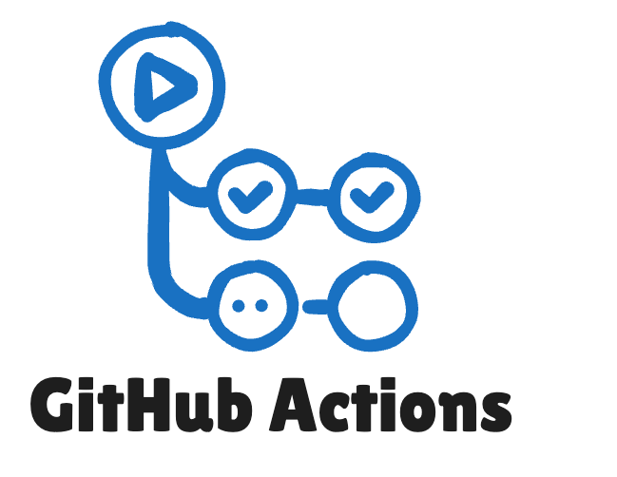






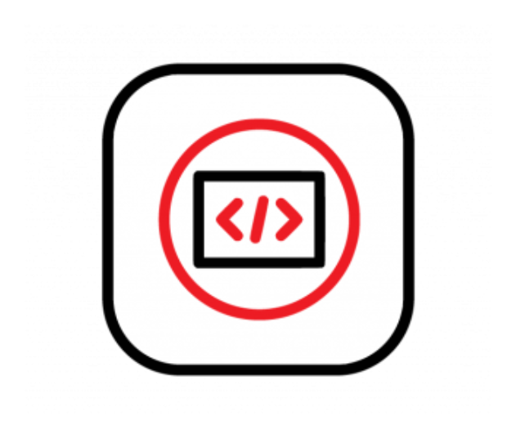
Tools
Your Github account where your code repository will belong
Feature from Github to create « CI/CD pipelines »
AWS S3 like. Where you will store your data and where mlFlow will store your artifacts
ML Swiss Knife. We will use it to track our experiments, store our ML artifacts and to run experiments with
its Command-Line Interface (CLI) from our Github Actions
Database used by mlFlow
Container registry. Free for open source purposes to any RedHat developers accounts. We will store our Docker
Images here.
Allows to create our training environments and webservice artifacts as containers
Enterprise platform built on Kubernetes. Simplifies deploying, managing, and securing containerized apps (as
mlFlow or our MLWebservice ;))
Free, cloud-based development environment that runs on a Red Hat OpenShift sandbox, allowing you
to develop and test applications without local setup.

Slide 8
BigPicture

Slide 9
!!!BIGWARNING!!!
DO NOT USE THIS SANDBOX ENVIRONMENT FOR ANY OF
YOUR PROFESSIONAL PROJECTS
DO NOT USE REAL DATA FROM AXA

Slide 10
Wanna play?
https://github.com/guillaume-thomas/summit-mlops-2025

Slide 11


Q&A
Software Engineering and Data Science
Xxxx, 2025

Slide 12
THANK YOU!
Software Engineering and Data Science
Xxxx, 2025

